Slide 1
Policy Frameworks For sustainable tourism
Lecture 6

Slide 2
First: Is sustainable tourism a “Wicked Problem”?
No definitive formulation of a wicked problem, unlike an ordinary problem.
No stopping rule, the problem is never fully resolved.
Solutions are neither true or false, but largely a matter of judgment.
No immediate or ultimate test of a solution, but instead unexpected consequences
No room for trial and error, as every implemented solution has consequences that cannot be undone.
No exhaustively describable set of potential solutions.
Essentially unique, experience does not help you address it.
A symptom of another problem, and is entwined with other problems, meaning there is no one root cause.
Can be explained in numerous ways, with different ideas about what the problem really is and what its causes are.
The planner has no right to be wrong, remedial actions will have a large impact and are hard to justify.

Slide 3
POLICY
1. International frameworks that govern tourism
2. International frameworks related to tourism
3. National regulations
4. Tourism master plans

Slide 4
1. International frameworks
Human Rights,
Rights of the Child
International Labour standards
Protection of the World’s Cultural & Natural Heritage (UNESCO)
Convention on Biodiversity,
Environment and Development (Rio and SDGs)
Climate Change (UNFCCC - Kyoto and Paris)

Slide 5


Slide 6
e.g. Human Rights
Human Rights issues that relate to tourism include:
Labour conditions and a living wage
Land rights and forced displacement
The rights of indigenous peoples
The right to water and sanitation
The right to life and health
The right to dignity and privacy
Economic exploitation
Cultural exploitation
Child labour
Sexual exploitation
The right to participate
And the newest human right:
Clean, Healthy, and Sustainable Environment

Slide 7
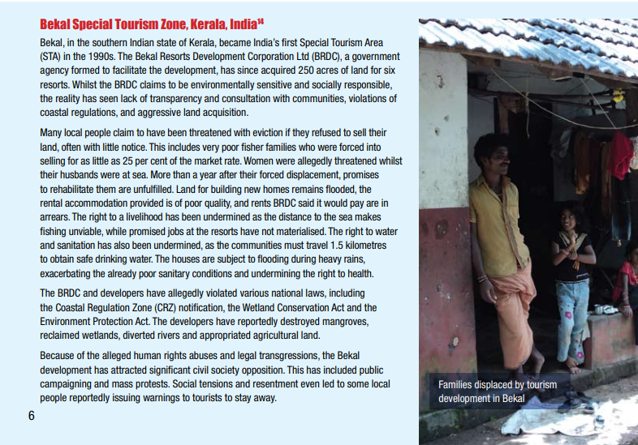
Case study: Tourism Concern 2014
Human Rights violations
Labour conditions and a living wage;
land and rights and forced displacement;
the rights of indigenous peoples;
the right to water and sanitation;
the right to life and health;
the right to dignity and privacy;
the prevention of economic exploitation

Slide 8
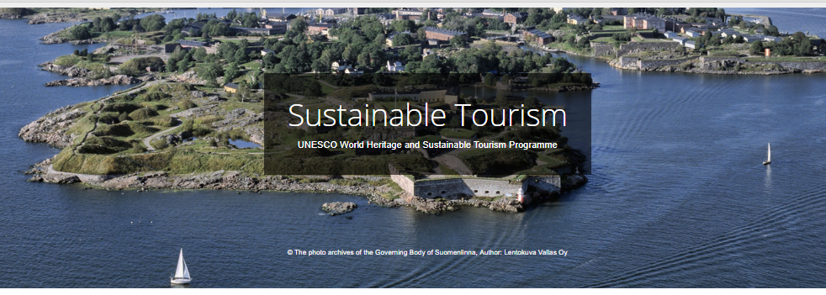
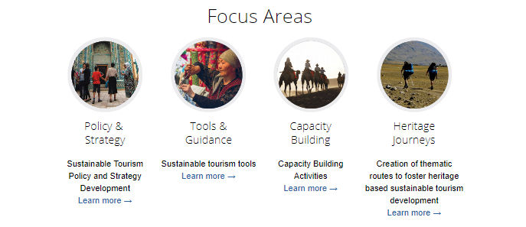

Slide 9
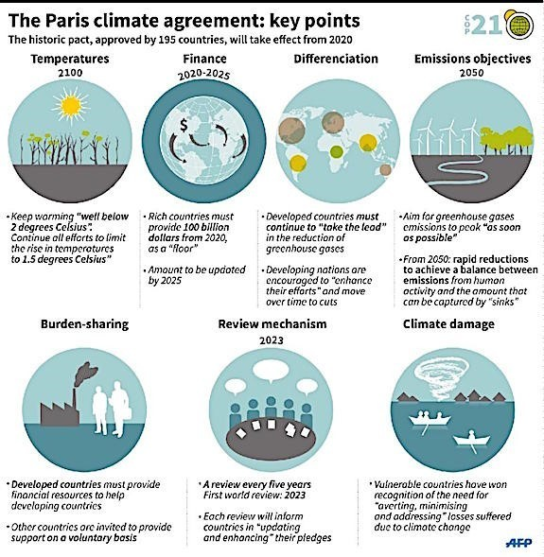

Slide 10
Other international frameworks
(continued)
International Covenant on Economic, Social and Cultural Rights (ICESCR),
International Covenant on Civil and Political Rights (ICCPR),
Protection of Wetlands (RAMSAR),
Convention on the trade of endangered species (CITES)
the UNEP’s Global Reporting Initiative (GRI)
The rights of movement, including visas and migration, also has an important impact on sustainable tourism development.

Slide 11


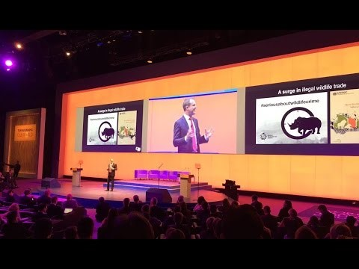

Slide 12

Rights of Nature

Slide 13
2.
Tourism-specific international frameworks
Warsaw Convention on Air Transport (1929),
Manila Declaration on World Tourism (1980)
Manila Declaration on Social Impact of Tourism (1997),
Quebec Declaration on Ecotourism (2002)
Djerba Declaration on Climate Change & Tourism (2003)
Davos Declaration on Climate Change & Tourism (2007)
Various Resolutions of the World Tourism Organisation’s (WTO) General Assembly.

Slide 14

UNWTO’s ONE PLANET
The Programme lists 4 objectives:
Integrating sustainable consumption and production (SCP) patterns in tourism related policies and frameworks
Collaboration among stakeholders for the improvement of the tourism sector´s SCP performance
Fostering the application of guidelines, instruments and technical solutions to prevent and mitigate tourism impacts and to mainstream SCP patterns among tourism stakeholders
Enhancing sustainable tourism investment and financing

Slide 15
3. National regulations
Building codes, e.g. Basil’s green flat roofs
Food production
Health and sanitisation regulations.
Transport and urban infrastructure, e.g. car use reduction in Paris and London
Waste disposal, e.g. France’s zero food waste
Zoning regulations

Slide 16

Supply chain management
The UN’s Global Reporting Initiative offers standards on supply chain management indicators for tourism
First level suppliers: directly supplying tourism services to tourists or their intermediaries (e.g. tour operators and travel agents). These will include accommodation providers, transport providers, food suppliers and so forth.
Second level suppliers, on the other hand, supply tourism service providers with products & services, e.g. energy and water service providers, food and drink manufacturing, waste recycling, and so forth.

Slide 17
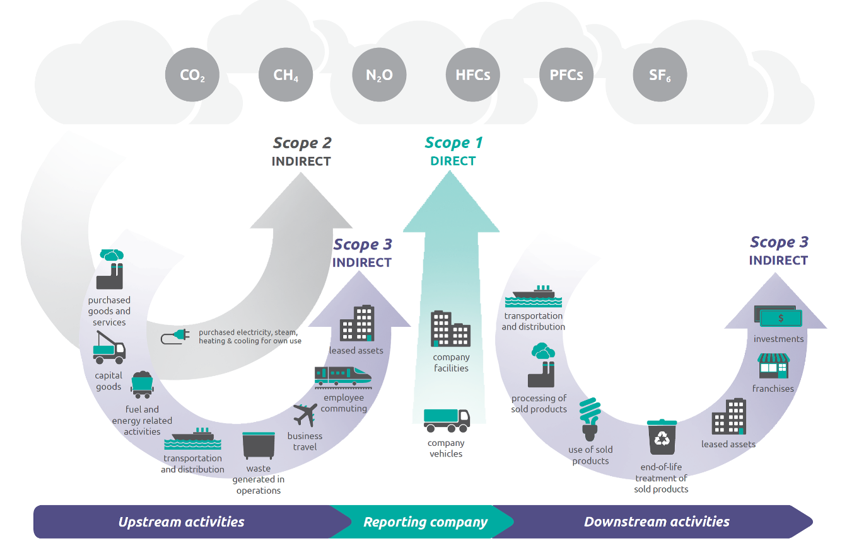
Green house gas protocol

Slide 18
TOURISM MASTER PLANS
Setting
Setting the course: holistic view of wider system, stakeholder engagement, long-term planning
Developing
Developing the approach: lifecycle approach, polluter pays, functional alternatives for best outcomes, limits on growth
Ensuring
Ensuring ongoing progress: adaptive management, and monitoring through the use of indicators

Slide 19

CASE STUDY: BHUTAN

Slide 20
3 different pathways to sustainable tourism
An organic path, with little planning, responding to changes in context, e.g. market needs and resource restrictions.
An incremental path, whereby core alternative tourism principles are accompanied by careful management of carrying capacities as the tourism destination increases in popularity.
An induced path, involving a deliberate regulatory approach that embraces growth and a sustainability-focussed ethic.

Slide 21
Next up….
What sorts of governance structures can support the implementation of policies etc? m

